Slide 1

YUKTI ID:
INNOVACT 2025
INTERNET OF THINGS(IOT)
A self-emptying smart dustbin that opens for you, empties itself, and returns home.
TEAM DUSTWIN
REET SHRIVASTAV(24BCE2241)
AKSHAT JONATHAN FERNANDES(24BCE0284)
GEETIKA RUPANI(24BIT0058)
PRANSHI GUPTA(24BCE2268)
PRATYUSH TAYAL(24BCE0583)

Slide 2
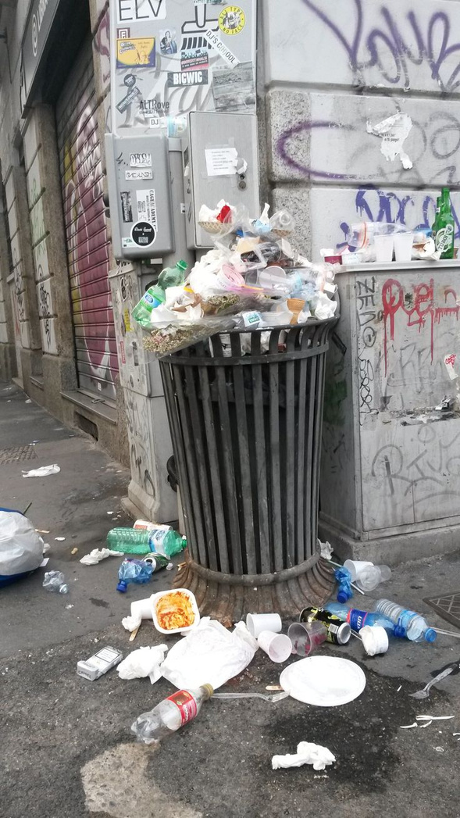
PROBLEM STATEMENT!
Modern waste management struggles with hygiene, efficiency, and sustainability. Manual handling of bins increases the risk of germ transmission, especially in hospitals, schools, offices, and public spaces. Unnoticed overflows cause odors, pests, and health hazards, while fixed-schedule collection leads to wasted labor, higher costs, and poor efficiency. With urbanization expected to reach 68% of the global population by 2050 (UN), and improper waste linked by the WHO to disease spread, the demand for touchless, intelligent, and efficient waste solutions has become more urgent, especially in the post-COVID era.

Slide 3
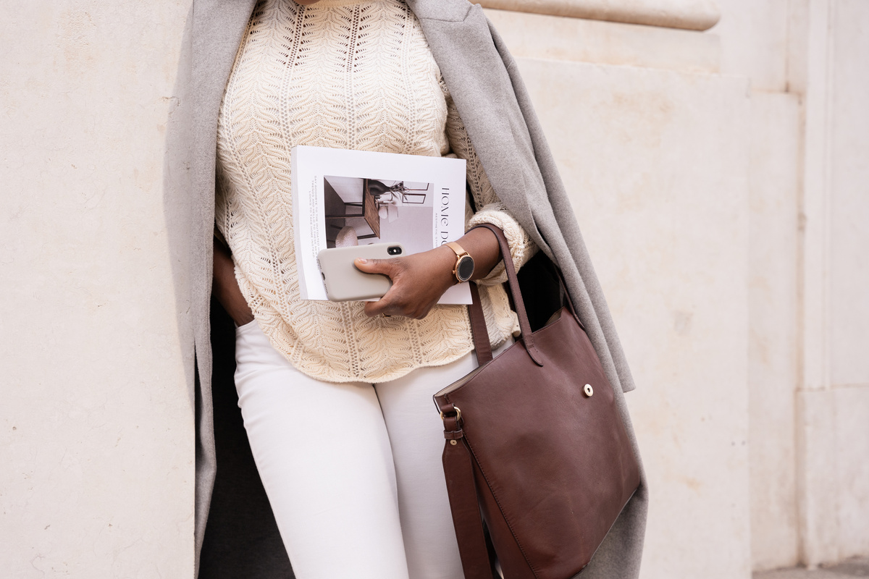

PROPOSED SOLUTION
The Smart Assistive Dustbin ensures hygienic, efficient waste handling with touchless lid operation, fill-level monitoring, and autonomous navigation via line-following sensors. A servo-driven mechanism enables automatic emptying, while an ESP32 controls functions and displays status on an LCD or app. Combining automation, mobility, and intelligence, it offers a modern, sustainable solution to today’s waste management challenges.

Slide 4

TECHNICAL APPROACH
TOOLS & COMPONENTS
CONTROLLER: ESP32
SENSORS: IR (LID + NAVIGATION), ULTRASONIC (FILL LEVEL)
ACTUATORS: SERVO MOTORS (LID + TILTING), DC MOTORS (MOBILITY)
POWER: LI-ION BATTERY WITH REGULATOR
OUTPUT: LCD / MOBILE APP
SOFTWARE: ARDUINO IDE (C/C++), IOT VIA BLYNK/MQTT

Slide 5
TECHNICAL APPROACH
WORKFLOW
IR sensor detects hand → Servo opens lid (touchless).
Ultrasonic sensor monitors waste fill level.
IR floor sensors guide line-following navigation.
Servo tilts bin to empty waste, then resets.
Bin docks for recharge/maintenance.
Status displayed on LCD/app.

Slide 6
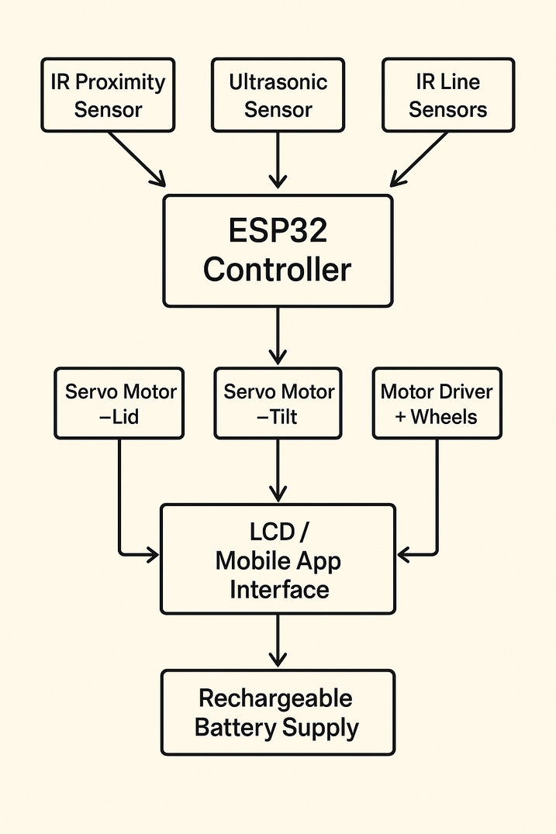
TECHNICAL APPROACH
ARCHITECTURE DIAGRAM

Slide 7
TECHNICAL APPROACH
IMPLEMENTATION
HARDWARE: ESP32, HC-SR04, IR SENSORS, SERVO/DC MOTORS, L298N DRIVER, LI-ION BATTERY, LCD.
SOFTWARE: ARDUINO IDE (C/C++), IOT DASHBOARD (BLYNK/MQTT).

Slide 8
IMPACTS & USECASES
WHO BENEFITS?
HOUSEHOLDS & APARTMENTS: HYGIENIC, TOUCHLESS DISPOSAL
HOSPITALS & PUBLIC SPACES: REDUCED DISEASE SPREAD
WASTE MANAGEMENT COMPANIES: OPTIMIZED ROUTES, COST SAVINGS
REAL-WORLD APPLICATIONS
AIRPORTS, MALLS, OFFICES: CLEAN, LOW-MAINTENANCE BINS
HOSPITALS & LABS: SAFE, CONTACTLESS DISPOSAL

Slide 9

CHALLENGES FACED
HARDWARE INTEGRATION
CHALLENGE: MULTIPLE COMPONENTS (MOTORS, SERVOS, IR SENSORS, ULTRASONIC) CAUSED WIRING CONFLICTS & UNSTABLE POWER SUPPLY.
SOLUTION: USED PROPER PIN MAPPING, MOTOR DRIVER (TB6612FNG), AND REGULATED POWER TO ENSURE STABLE OPERATION.
ULTRASONIC FILL DETECTION
CHALLENGE: ULTRASONIC SENSOR GAVE UNSTABLE READINGS INSIDE THE DUSTBIN.
SOLUTION: USED AVERAGING OF MULTIPLE READINGS + MAPPED VALUES TO A FIXED RANGE FOR STABLE FILL-LEVEL PERCENTAGE.

Slide 10
FUTURE SCOPE
Smarter Waste Management
Add AI/Camera-based recognition to automatically classify recyclable vs. non-recyclable waste.
Enable real-time data sharing with municipalities for predictive waste collection.
Better Connectivity
Add Wi-Fi modules so bins send fill-status directly to waste collection systems.
Integrate into Smart City dashboards for route optimization.
Improved Hardware
Use rechargeable battery with solar charging → fully sustainable operation.
Add stronger, compact motors for smoother movement & better load handling.

Slide 11
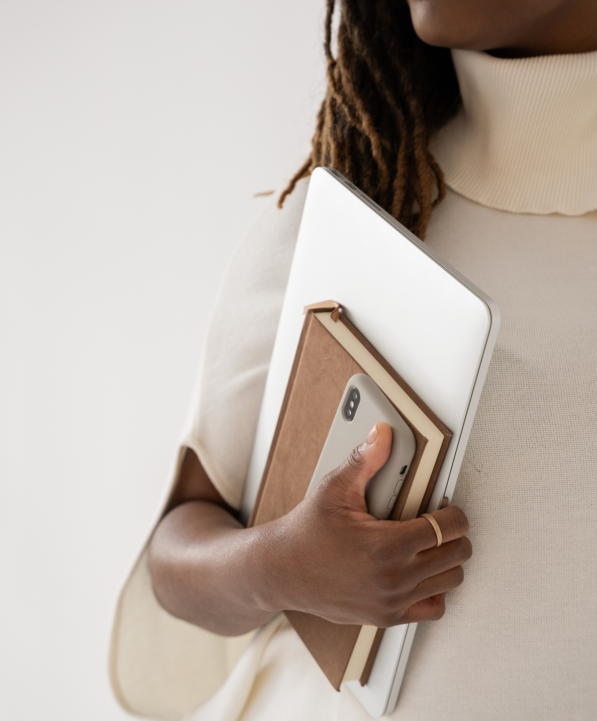
CONCLUSION
Our Smart Dustbin provides a hygienic, touchless, and automated waste management solution by integrating ESP32 with sensors, servo motors, and ultrasonic detection. The system automatically opens its lid, monitors the fill level, and navigates autonomously, reducing human effort and promoting cleanliness. What makes this project stand out is its potential to scale into smart city infrastructure, offering a sustainable and efficient approach to waste handling in households, hospitals, and public spaces.

Slide 12

Credits
This presentation template is free for everyone to use thanks to the following:
for the presentation template
Pexels, Pixabay
for the photos
Happy designing!

